Slide 1
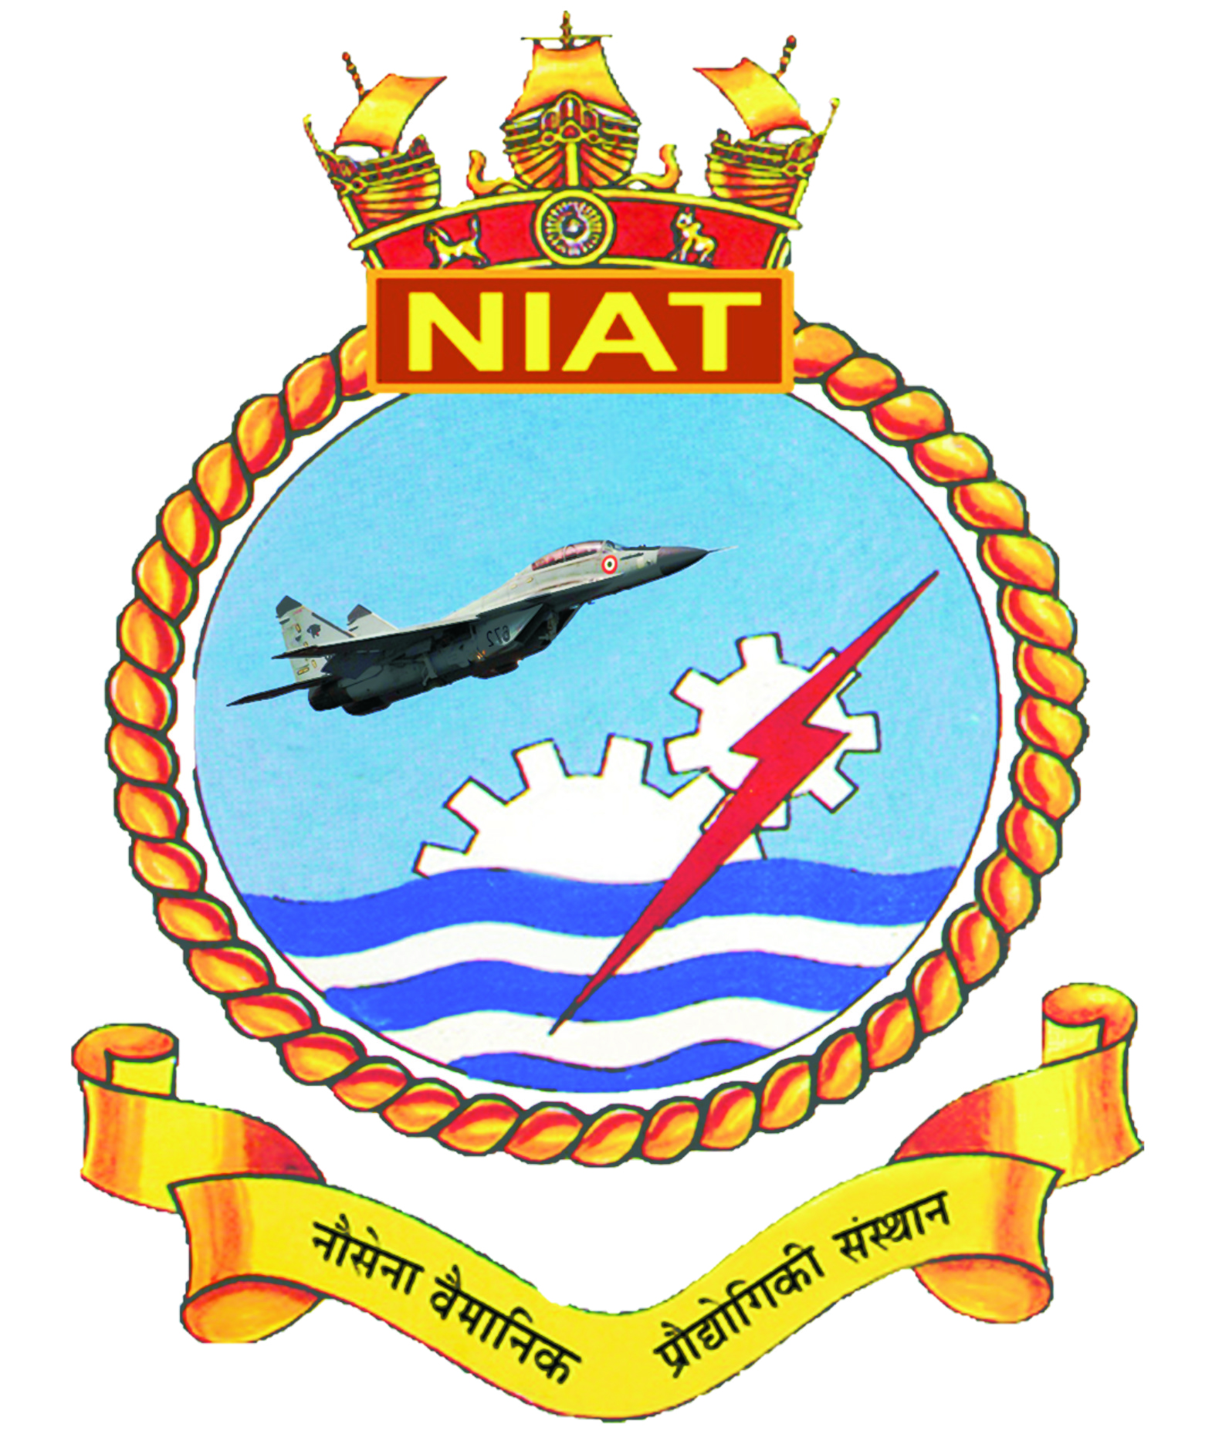
Identification of various structural parts
Presented by:
SLt Viraj Simpi
Vetted By:
Commander. Vivek Ratee

Slide 2
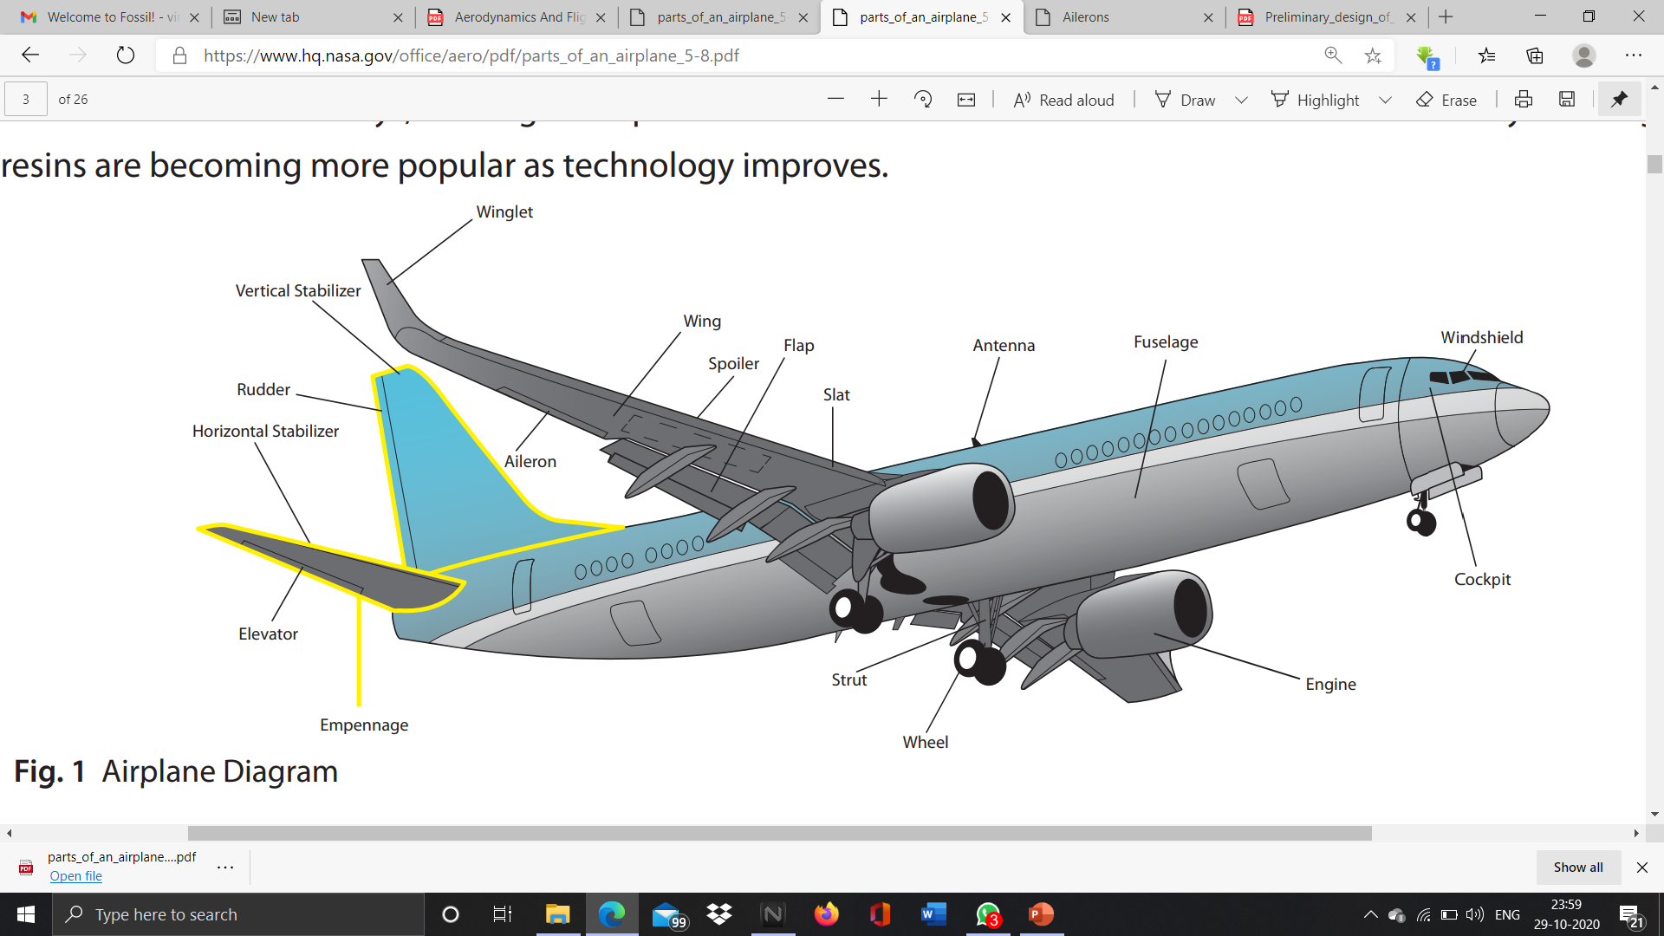
introduction

Slide 3
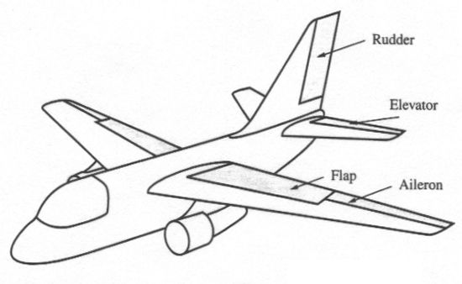
aileron
The ailerons are located at the rear of the wing, typically one on each side.
They work opposite to each other, meaning that when one is raised, the other is lowered.

Slide 4
aileron
Their job is to increase the lift on one wing while reducing the lift on the other. By doing this, they roll the aircraft sideways, causing the aircraft to turn.
This is the primary method of steering a fixed-wing aircraft.

Slide 5
antenna
There are numerous radio antennas located around an aircraft, their size and position corresponding to the type of work each antenna must perform and the frequencies being transmitted or received
The GPS antenna, for example, is always mounted to the top of an airplane. This is because the GPS satellites are in Space, and therefore always above the aircraft

Slide 6
antenna
As a general rule, longer antennas are used for radio communication and navigation (VHF frequencies)
Shorter antennas are reserved for higher frequency data such as the GPS signals and the transponder, which provides air traffic control with information about the aircraft’s position and altitude

Slide 7
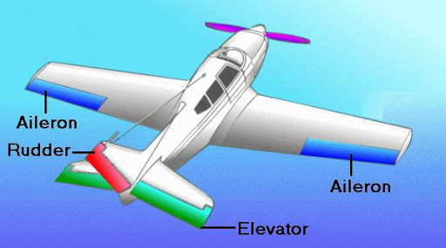
elevator
As the name implies, the elevator helps “elevate” the aircraft.
It is located on the tail and directs the nose of the aircraft either upwards or downwards (pitch) in order to make the airplane climb and descend

Slide 8
empennage
This name stems from the French word “empenner,” meaning “to feather an arrow”.
The empennage is the name given to the entire tail section of the aircraft, including both the horizontal and vertical stabilizers, the rudder and the elevator.
As a combined unit, it works identically to the feather on the arrow, helping guide the aircraft to its destination.

Slide 9
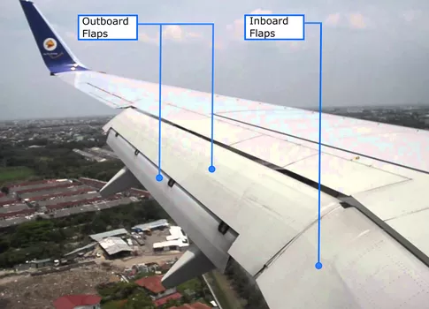
FLAP
Flaps are a “high lift / high drag” device.
Not only do they improve the lifting ability of the wing at slower speeds by changing the camber, or curvature of the wing, but when extended fully they also create more drag.
This means an aircraft can descend (or lose altitude) faster, without gaining airspeed in the process

Slide 10
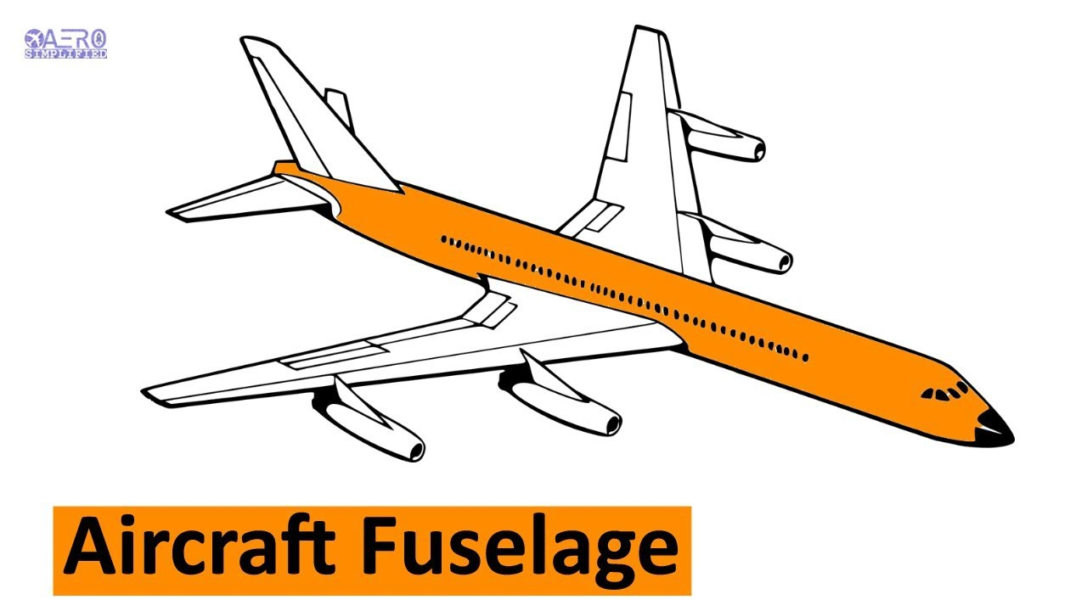
FUSELAGE
The fuselage, from the French word “fuselé” meaning “spindle shaped”, is the portion of the airplane used to literally join, or fuse, the other parts together.
It is commonly thought of as the body of the aircraft and holds the passengers and cargo safely inside.

Slide 11
HORIZANTAL STABILIZER
The horizontal stabilizer is quite simply an upside-down wing, designed to provide a downward force (push) on the tail.
Airplanes are traditionally nose-heavy and this downward force is required to compensate for that, keeping the nose level with the rest of the aircraft.
Some aircraft can control the angle of the stabilizer and therefore the level of downward force while in flight, while others are fixed in place

Slide 12
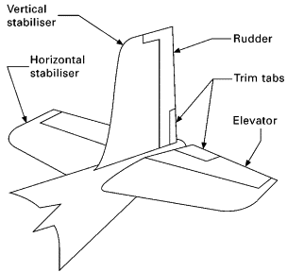
RUDDER
The rudder is attached to the vertical stabilizer, located on the tail of the aircraft
It works identically to a rudder on a boat, helping to steer the nose of the aircraft left and right; this motion is referred to as yaw
Unlike the boat however, it is not the primary method of steering
Its main purpose is to counteract certain types of drag, or friction, ensuring that the aircraft’s tail follows the nose, rather than sliding out to the side

Slide 13
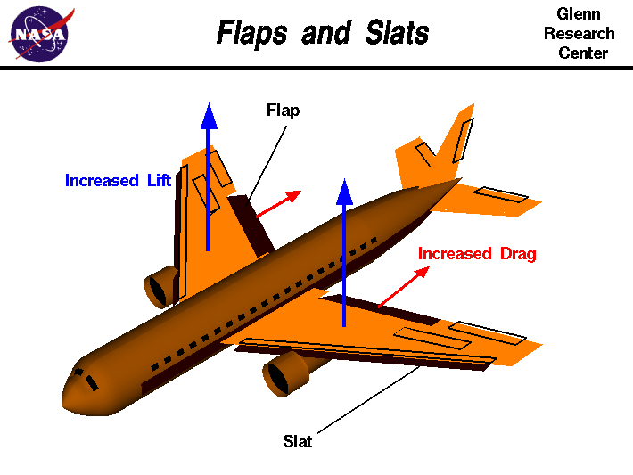
SLAT
A slat is a “high lift” device typically found on jet-powered aircraft. Slats are similar to the flaps except they are mounted on the leading edge of the wing
They also assist in changing the camber, or curvature of the wing, to improve lifting ability at slower speeds

Slide 14
SPOILER
The spoiler’s function is to disrupt, or spoil, the flow of air across the upper surface of the wing
They are usually found on larger aircraft, which can have two types installed
The in-flight spoilers are small and designed to reduce the lifting capability of the wing just enough to allow the aircraft to descend quicker without gaining airspeed
The ground spoilers typically deploy automatically on landing and are much larger than their in-flight cousins
Notes:
. The in-flight spoilers are small and designed to reduce the lifting capability of the wing just enough to allow the aircraft to descend quicker without gaining airspeed. Although the flaps can also perform this function, the spoiler is intended to be used temporarily, while the flaps are typically used for longer durations such as during the approach and landing. The ground spoilers typically deploy automatically on landing and are much larger than their in-flight cousins. They are used to completely destroy the lifting ability of the wing upon landing, ensuring that the entire weight of the airplane rests firmly on the wheels, making the brakes more effective and shortening the length of runway needed to stop the aircraft

Slide 15
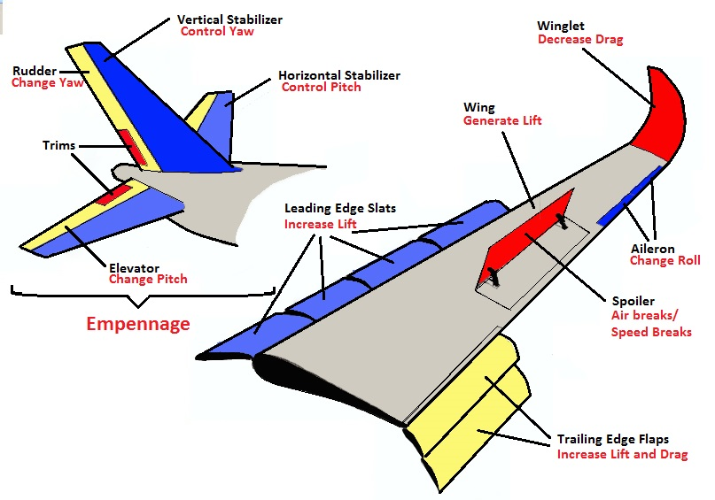
spoiler

Slide 16
STRUTS
The struts are part of the undercarriage, more commonly known as the landing gear. Their function is to absorb the impact of the landing as the aircraft touches the ground
Each strut contains a shock absorber (a collection of springs), hydraulic oil and gasses which work together to reduce the impact felt by the passengers.
On some aircraft, such as those used by student pilots, the struts are made entirely out of spring steel. This type of steel is treated in such a way that it can absorb the shock of landings repeatedly, bending automatically back into shape.

Slide 17
VERTICAL STABILIZER
The vertical stabilizer is designed to stabilize the left-right motion of the aircraft
While most aircraft use a single stabilizer, some models, such as the Lockheed C-69 Constellation, use multiple, smaller stabilizers.

Slide 18
WINDSHIELD
The windshield on smaller aircraft is usually made from polycarbonate, a type of plastic, while pressurized airplanes use a sandwich of plastic and glass layers, called a laminate, up to 20mm thick
This is necessary to absorb the impact of birds, insects and other debris that may collide with the windshield as the airplane flies at close to the speed of sound.

Slide 19
WING
The wing provides the majority of the lift an airplane requires for flight. Its shape is specifically designed for the aircraft to which it is attached. On most aircraft, the interior of the wing is also used to store the fuel required to power the engines.

Slide 20
WINGLET
Some aircraft wings have an additional component called a winglet, which is located at the end of each wing
Its purpose is to reduce the drag (or air resistance) the wing produces as it pushes through the air
It allows the airplane to fly faster, but also means it burns less fuel, allowing it to fly longer distances without refueling.

Slide 21
wheel
The wheels are another part of the undercarriage, or landing gear. While most aircraft have a minimum of three wheels, larger aircraft require many more to support their immense weight
Typically aircraft wheels are filled with nitrogen instead of air. This is because the pressure of nitrogen gas changes very little with changes in altitude or temperature, which is something aircraft constantly experience

Slide 22
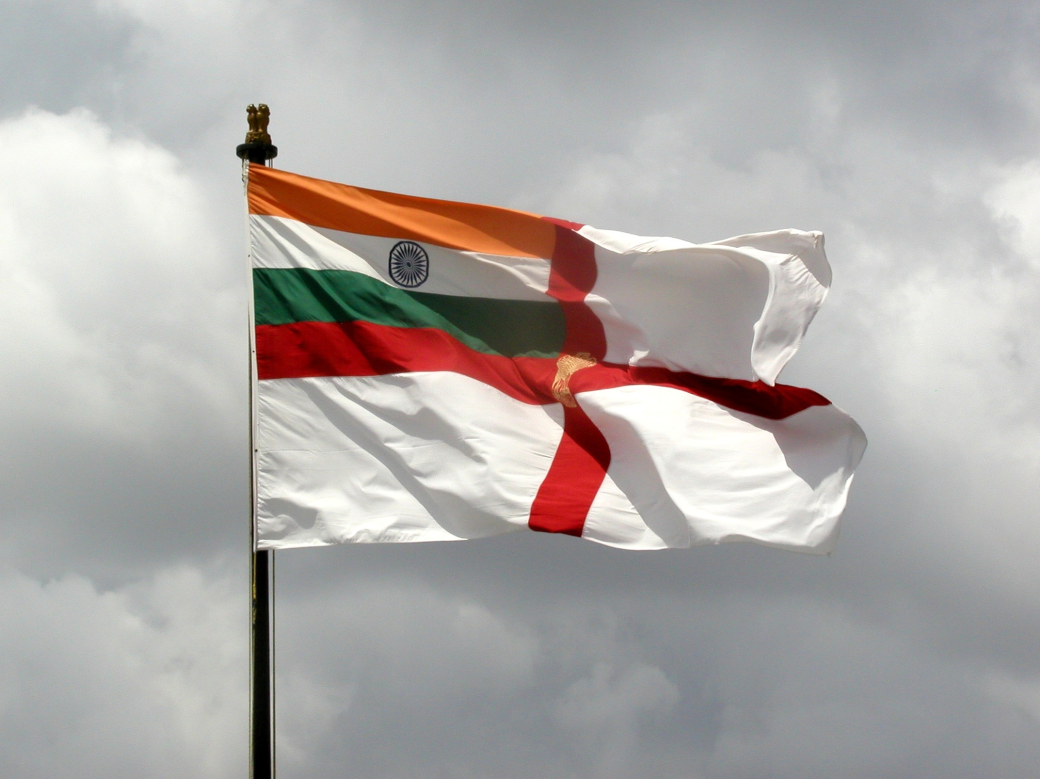
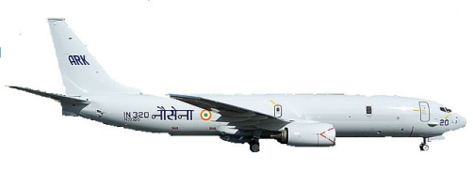
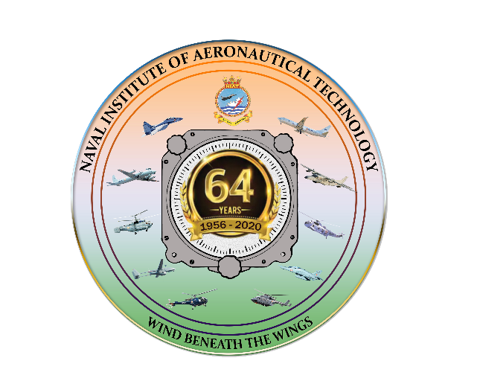
Thank You

